Slide 1
Job Tracking.

Slide 2
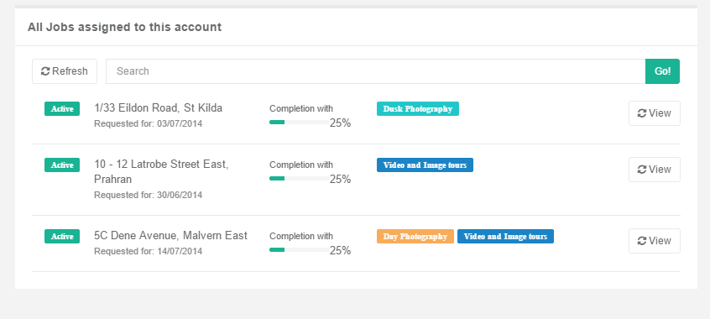
When the user hovers over the Product Group, it should give the user the date and time of the event.

Slide 3
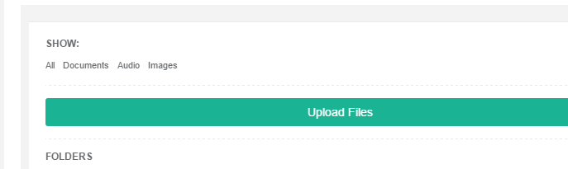
The document extensions are not done?

Slide 4
S3 download Issue.
http://ceph.com/docs/master/radosgw/s3/csharp/
We probably need to get the file programmatically.
See this section
GENERATE OBJECT DOWNLOAD URLS (SIGNED AND UNSIGNED)

Slide 5
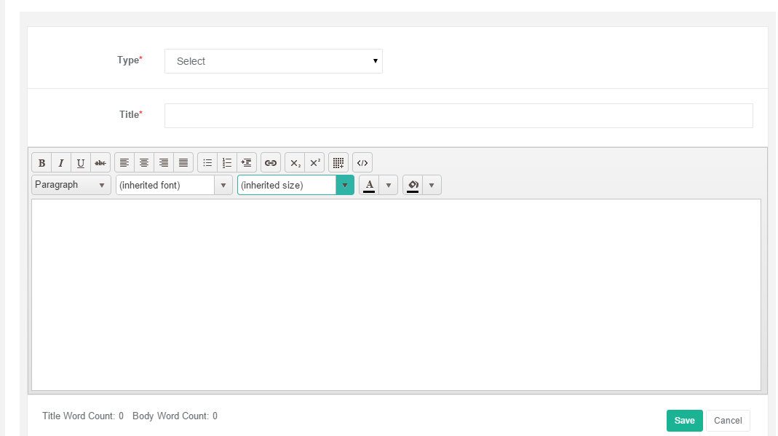
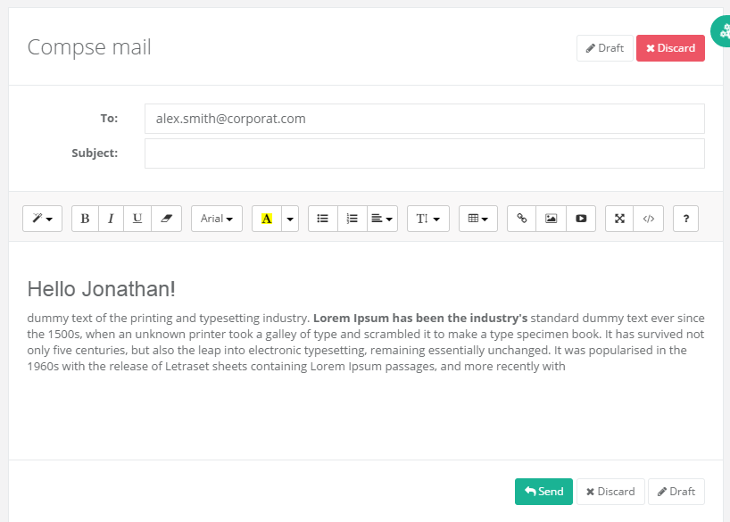
Your implementation does not look clean like the template version. Please correct.

Slide 6
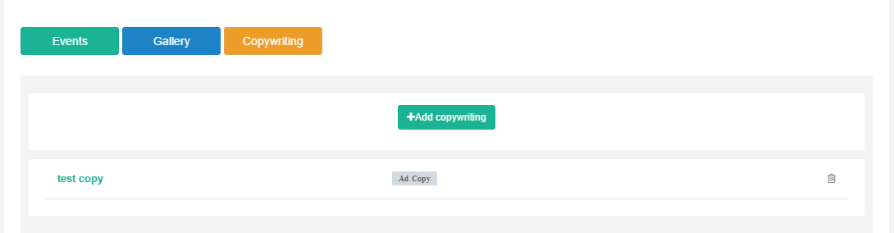
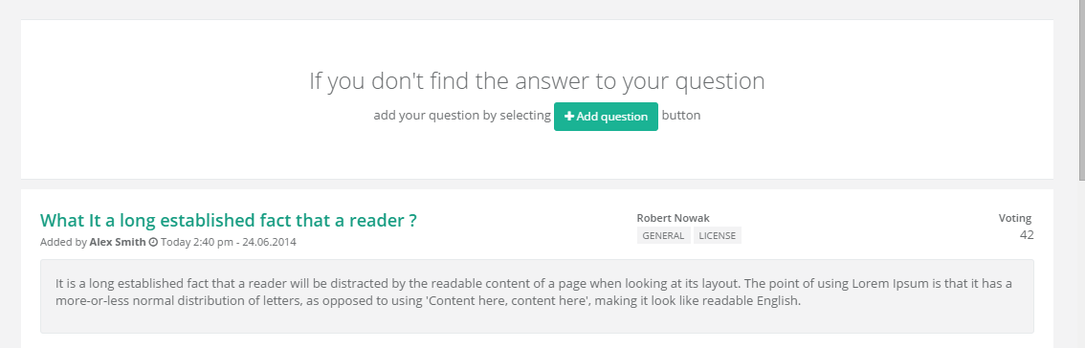
This does not look like this design????

Slide 7

When you click add, it takes ages to load. Why?

Slide 8
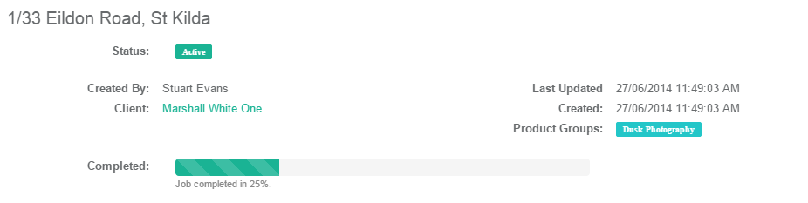
Can we clean up the alignment.

Slide 9
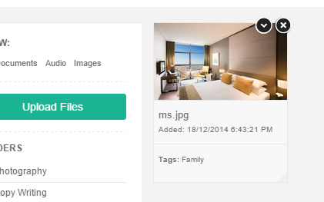
1. We don’t need the animation on hover. 2. We are still missing the starred function.

Slide 10
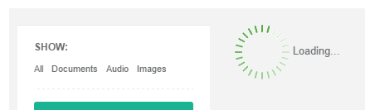
Is there another loading icon?

